Slide 1
NUMBER
THEORETIC
ALGORITHMS

Slide 2
G.C.D.
Euclid’s Algorithm

Slide 3
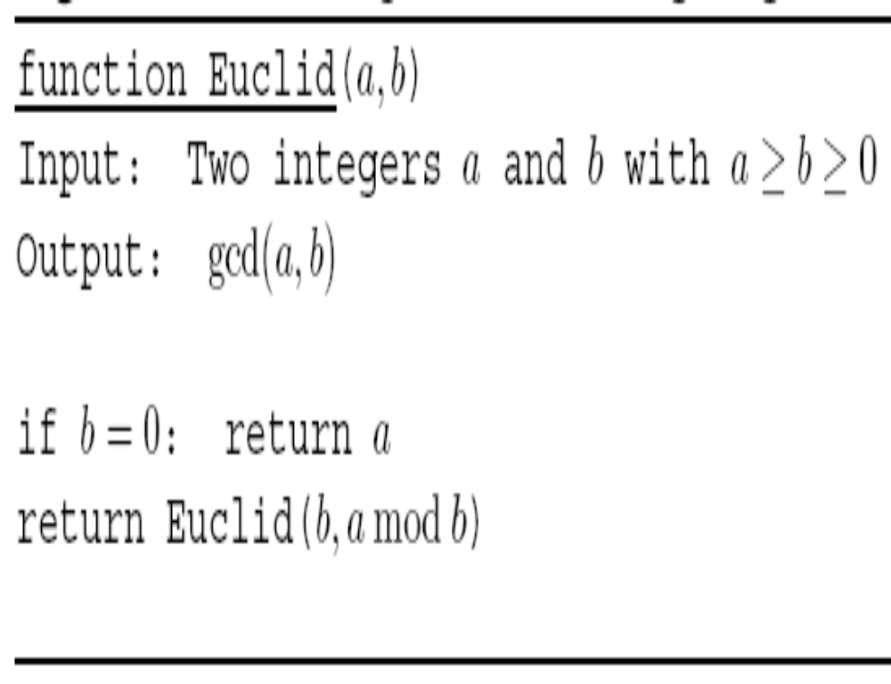

Slide 4
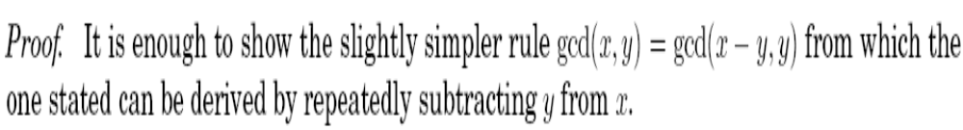
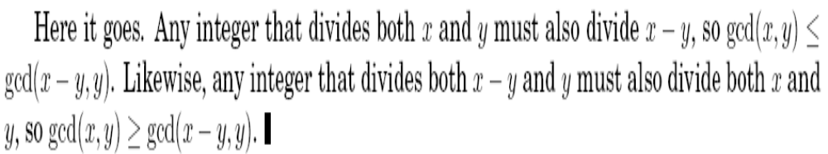

Slide 5
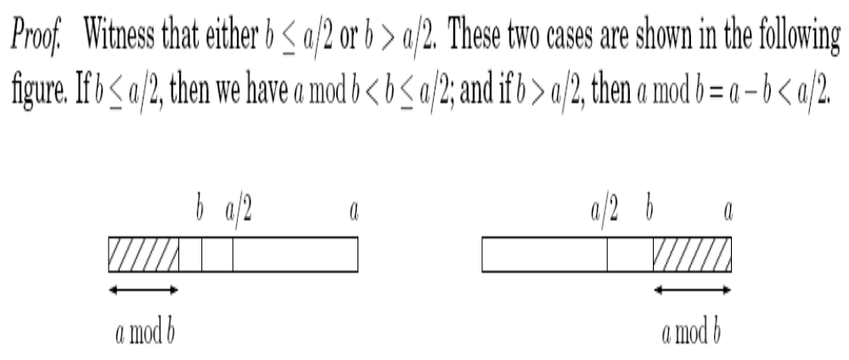
ANALYSIS

Slide 6
EXTENDED EUCLID ALGORITHM

Slide 7
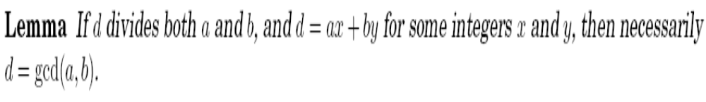
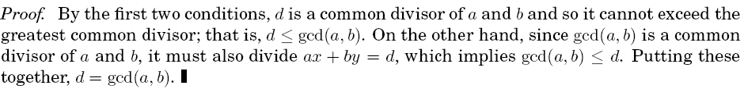

Slide 8
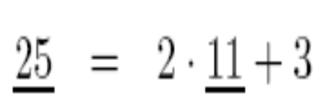
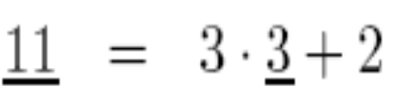
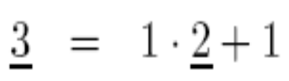
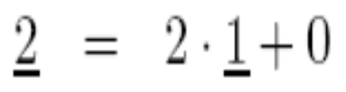
How to find such x & y

Slide 9
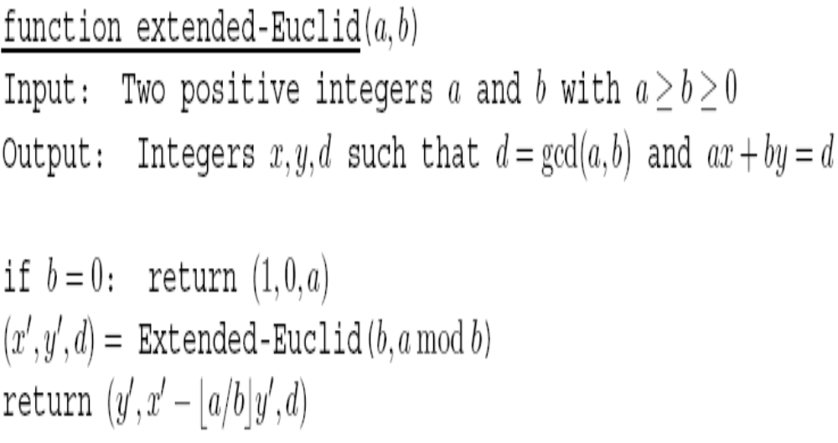
The ALGORITHM

Slide 10

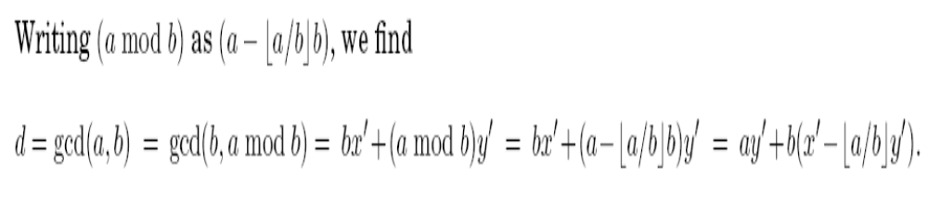
Inductive hypothesis:

Slide 11
MODULAR DIVISION

Slide 12
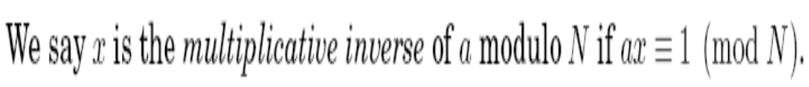
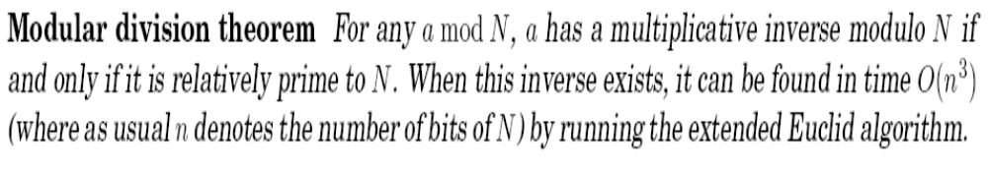

Slide 13
Public-Key Cryptography

Slide 14
How To Publish the Key and yet be Secure ?
Representation matters!

Slide 15
Ease/Speed of Operation Depends on The Representation
  viii * xvi = cxxviii
  8 * 16 = 128
  2³ * 2⁴ = 2⁷
  viii + xvi = xxiv
  8 + 16 = 24
  2³ + 2⁴ = 2³.3
  viii < ix is true
  8 < 9 is true
  2³ < 3² is true

Slide 16
Why is the Decimal System Popular?
 | Addition | Multiplication | Comparison
ROMAN | SLOW | SLOW | SLOW
DECIMAL | FAST | MEDIUM | FAST
PRIME PRODUCT | SLOW | FAST | MEDIUM
RESIDUE SYSTEM | FAST | FAST | MEDIUM

Slide 17
Slowness is ADVANTAGEOUS too!
Public Key Cryptography

Slide 18
Public-Key Cryptography
Choose Key K
(in representation R₁)
E_{K}(m)
Key K
(in representation R₂)
m
E⁻¹_{K}(E_{K}(m)) = m
In Representation R₂
  Operation E_{K} is FAST
  Operation E_{K}⁻¹ is VERY SLOW
In Representation R₁
  Operation E_{K}⁻¹ is FAST
EXAMPLE RSA Cryptosystem
R₁ : Product of Primes
R₂ : Decimal
E_{K} : Modular Exponentiation
m^{e} mod K

Slide 19
RSA
Pick any two primes p and q and let N = pq.
For any e relatively prime to (p -1)(q - 1):
The mapping f(x) = x^{e} mod N is a bijection on {0, 1, … N-1}
Moreover, the inverse mapping is easily realized: let d be the inverse of e modulo (p -1)(q - 1).
Then for all x in {0,…N-1}
(x^{e})^{d} mod N = x mod N

Slide 20
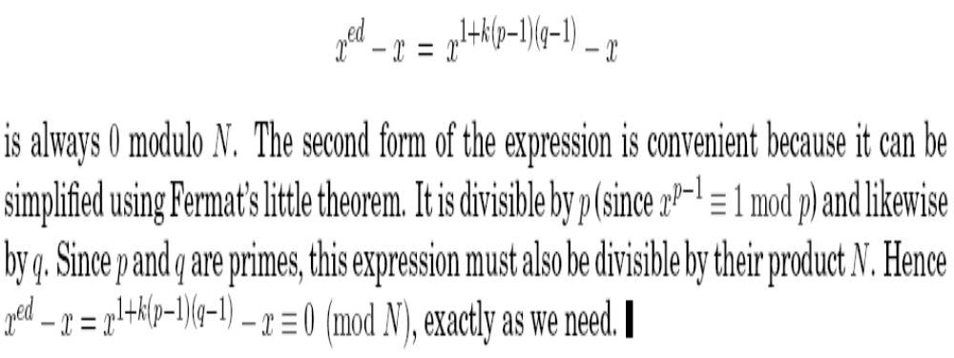
RSA (Corretness)

Slide 21
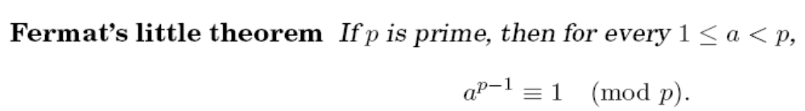
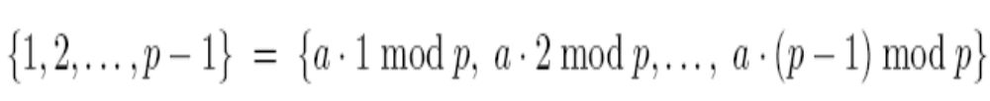
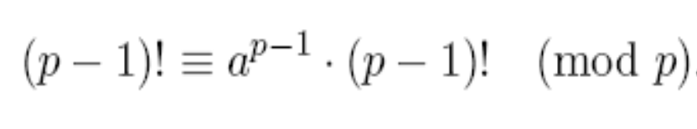

Slide 22
THANK YOU
Any Questions?
SUMMARY:
Euclid’s G.C.D.
Modular Division
Fermat’s Little Theorem
RSA Cryptosystem

